Slide 1
DASHBOARD DEVELOPMENT PHASE
Data Visualization &
Dashboard Development
Healthcare, Hospitality and Security Trends Dataset — Interactive Dashboard Suite
TEAM 2
Kunal • Dinesh • Sarumathi

Slide 2
PROJECT OVERVIEW
Team & Stage Objective
T
Team 2
STAGE OBJECTIVE
Turn the cleaned, analysis-ready dataset from the preprocessing stage into an interactive multi-page dashboard suite that surfaces hospital network performance, quality, satisfaction, resource and innovation insights.
K
Kunal
D
Dinesh
1
Connect cleaned dataset
2
Define KPIs & metrics
S
Sarumathi
3
Design dashboard layout
4
Build quality & satisfaction visuals
DATASET
Healthcare, Hospitality and Security Trends Dataset
Add maps, filters & Q&A
Compile insights & narrative
5
6
Team 2 • Healthcare, Hospitality & Security Trends
2

Slide 3
ROADMAP
From Clean Data to Dashboards
The analysis-ready dataset produced in the preprocessing stage now powers 7 interactive dashboards covering the hospital network, quality & risk, satisfaction drivers, resources, hospitality, patient flow and innovation trends.
1
2
3
4
5
6
7
→
→
→
→
→
→
Load Cleaned
Data
Define
KPIs
Choose
Visuals
Build
Dashboard Pages
Add Filters
& Q&A
Validate
Numbers
Publish
Dashboard Suite
WHY THIS STAGE MATTERS
Converts typed, encoded and engineered fields into readable visuals and KPI cards.
Turns 1,600 hospital records across 10 cities into an explorable, filterable dashboard suite.
Surfaces patterns in quality, satisfaction, capacity and digital adoption for decision-making.
Team 2 • Healthcare, Hospitality & Security Trends
3

Slide 4
PROCESS & TOOLS
Building the Dashboard Suite
DEVELOPMENT PROCESS
TOOLS & TECHNOLOGIES
Connect the cleaned dataset as the single source for every visual
P
Power BI
Design KPI summary cards for headline network metrics
Primary dashboard tool — used to build every KPI card, chart, map, heatmap, decomposition tree, filter panel and the interactive Q&A visual shown across the 7 dashboards.
Select chart types suited to each metric (bar, map, heatmap, donut, gauge)
Group related visuals into themed dashboard pages
Py
Python & Pandas
Layer in filters, slicers, a decomposition tree and a Q&A search box
Feeds the dashboard suite with the typed, encoded and feature-engineered dataset produced in the preprocessing stage.
Add narrative call-outs and validate every number against the dataset
Dashboard components used: KPI cards · bar & column charts · donut charts · city map · heatmap matrix · decomposition tree · gauge · filters/slicers · Q&A box · narrative panels
Team 2 • Healthcare, Hospitality & Security Trends
4

Slide 5
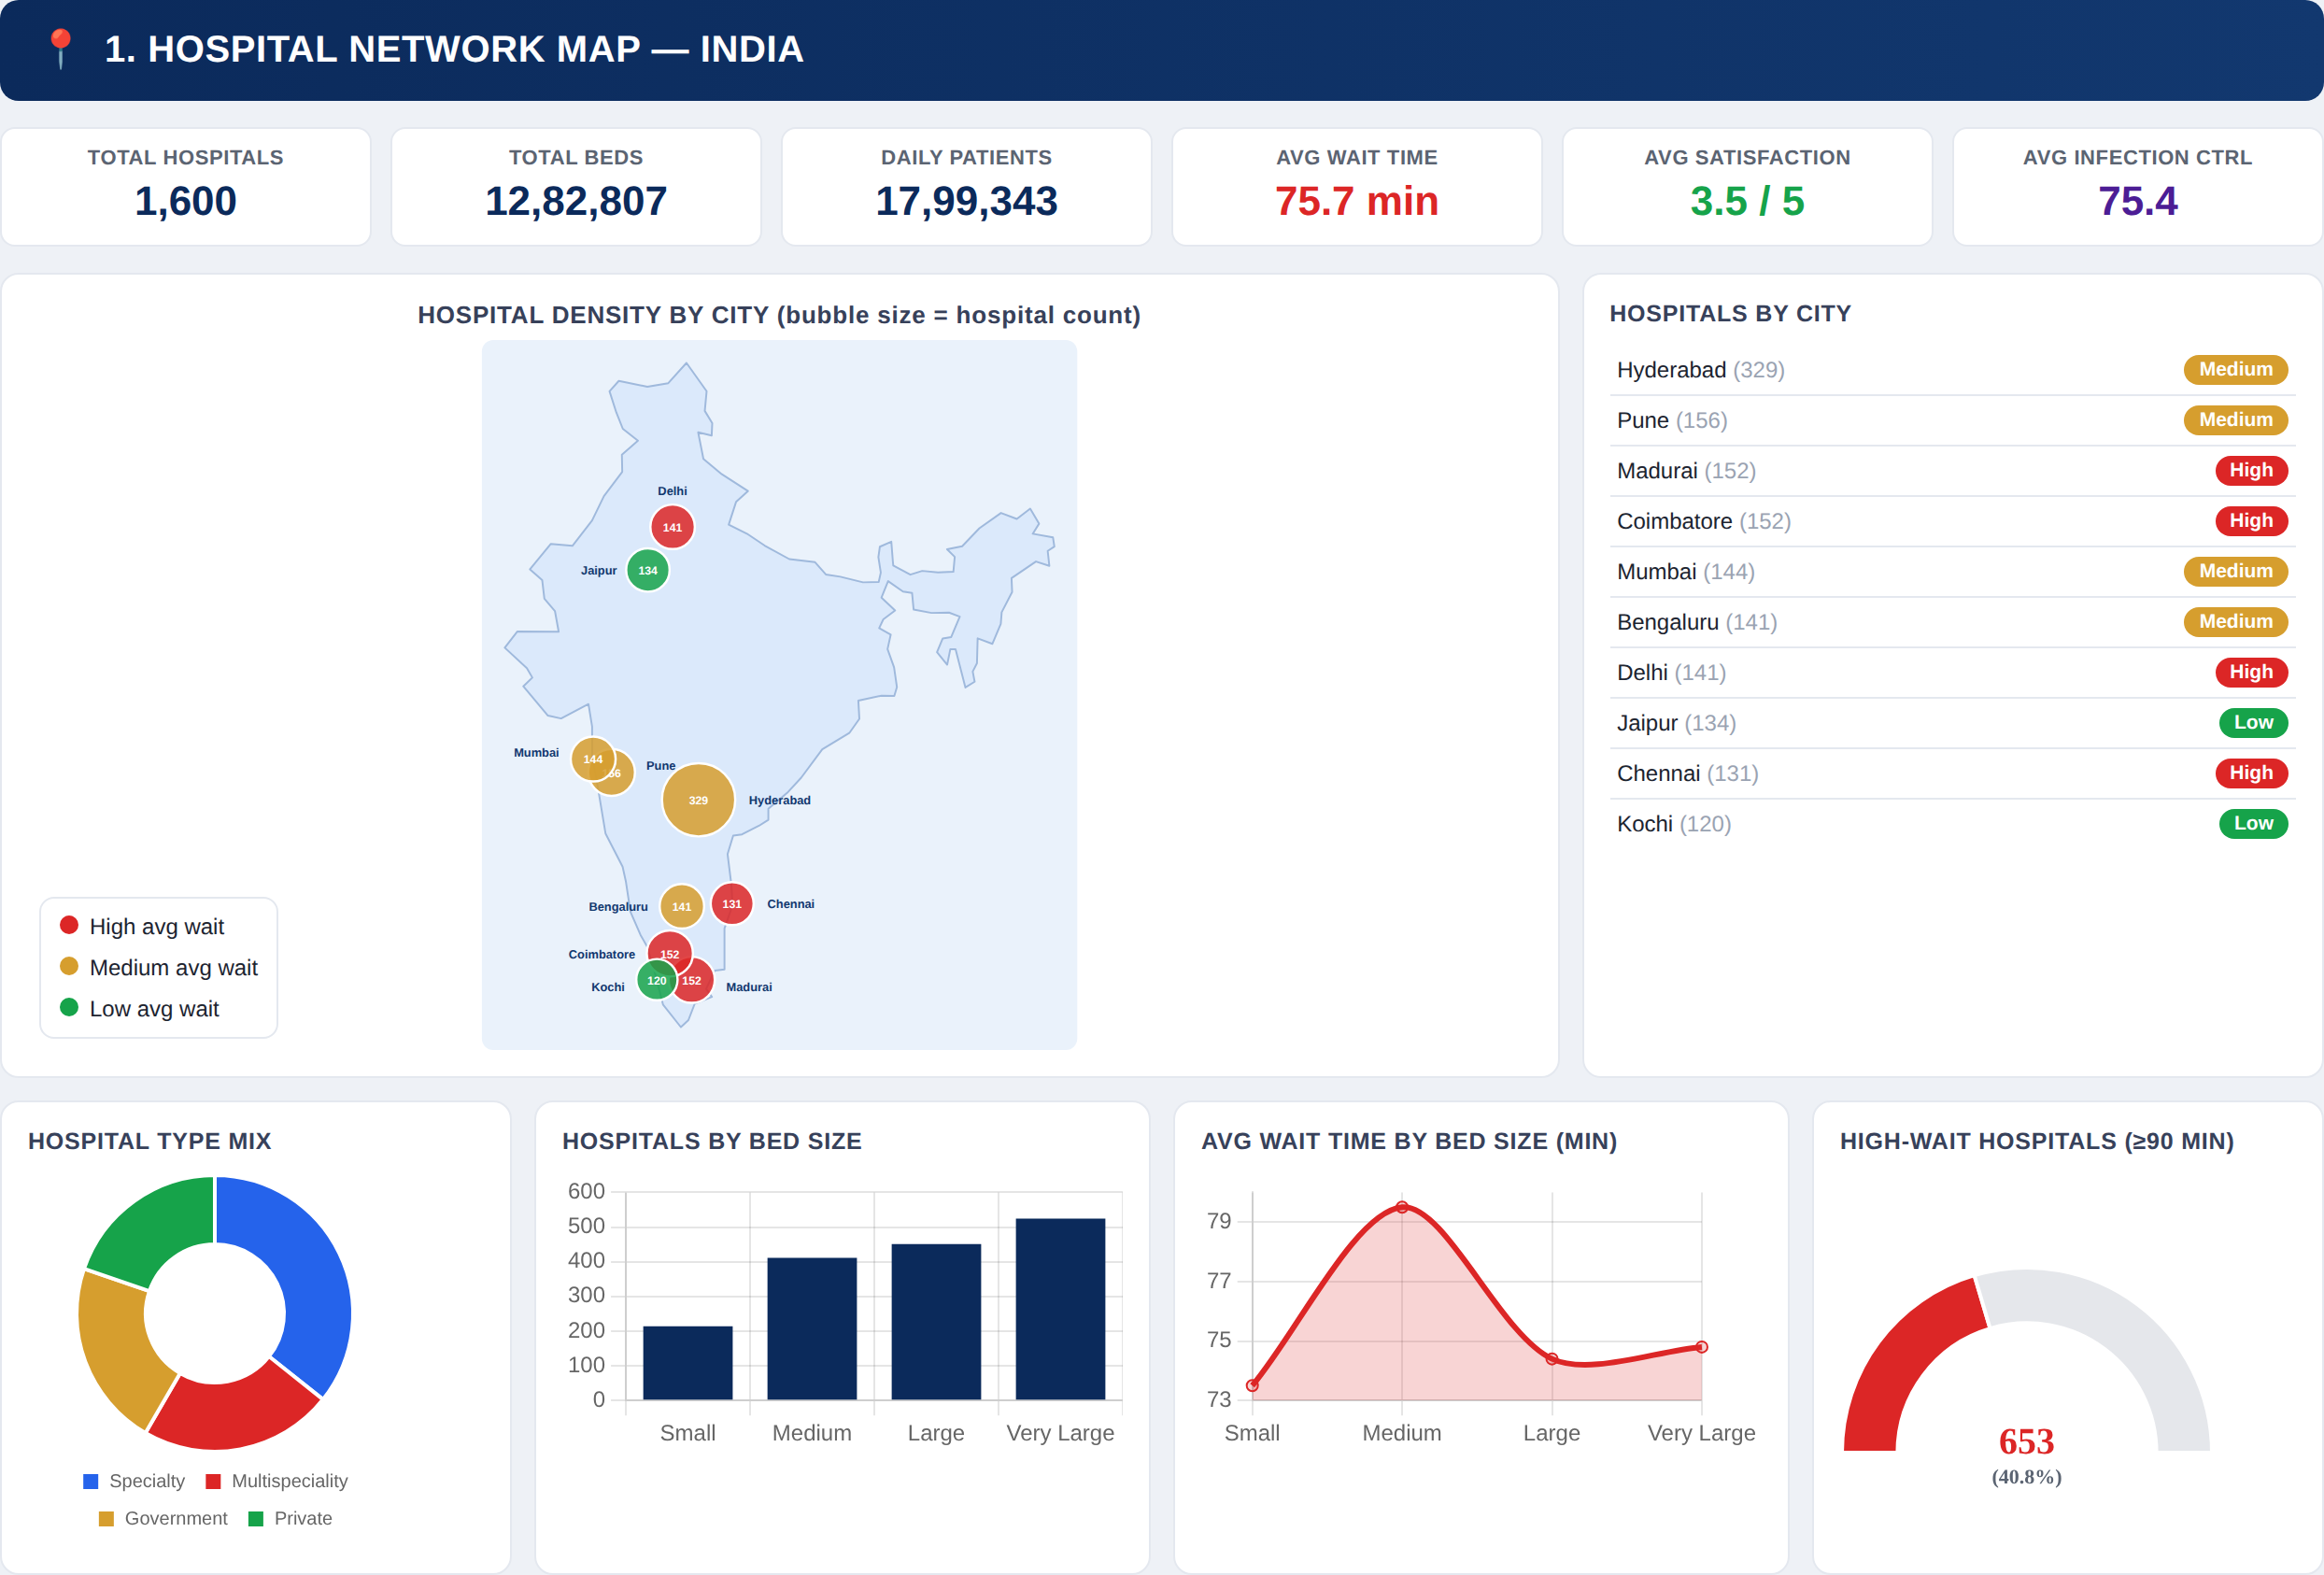
DASHBOARD 1 OF 7
Hospital Network Map — India
Network-wide footprint across 10 cities
AT A GLANCE
1,600
12.8L
TOTAL HOSPITALS
TOTAL BEDS
75.7 min
3.5 / 5
AVG WAIT TIME
AVG SATISFACTION
KEY OBSERVATIONS
Hyderabad has the largest hospital count (329), well ahead of every other city.
653 hospitals (40.8%) report a high wait time of 90+ minutes.
Medium-bed hospitals show the longest average wait (79.2 min) of any bed-size group.
Team 2 • Healthcare, Hospitality & Security Trends
5

Slide 6
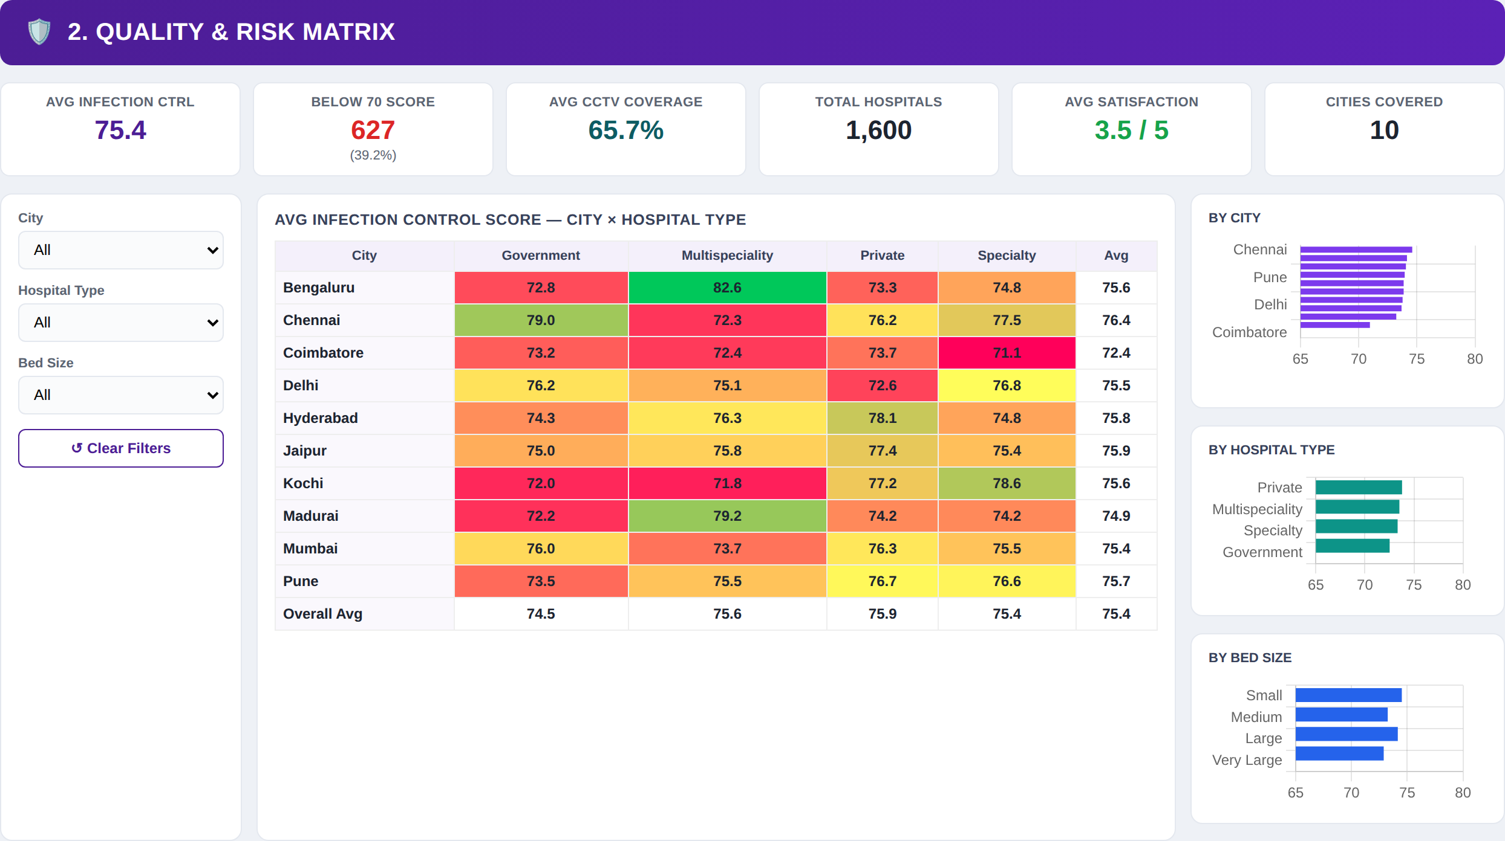
DASHBOARD 2 OF 7
Quality & Risk Matrix
Infection control performance by city and hospital type
AT A GLANCE
75.4
39.2%
AVG INFECTION CTRL
BELOW 70 SCORE
65.7%
10
AVG CCTV COVERAGE
CITIES COVERED
KEY OBSERVATIONS
Bengaluru Multispeciality hospitals score highest on infection control (82.6).
Coimbatore Specialty hospitals score lowest (71.1), pulling the city average down to 72.4.
Private hospitals post the strongest infection-control average by type (75.9).
Team 2 • Healthcare, Hospitality & Security Trends
6

Slide 7
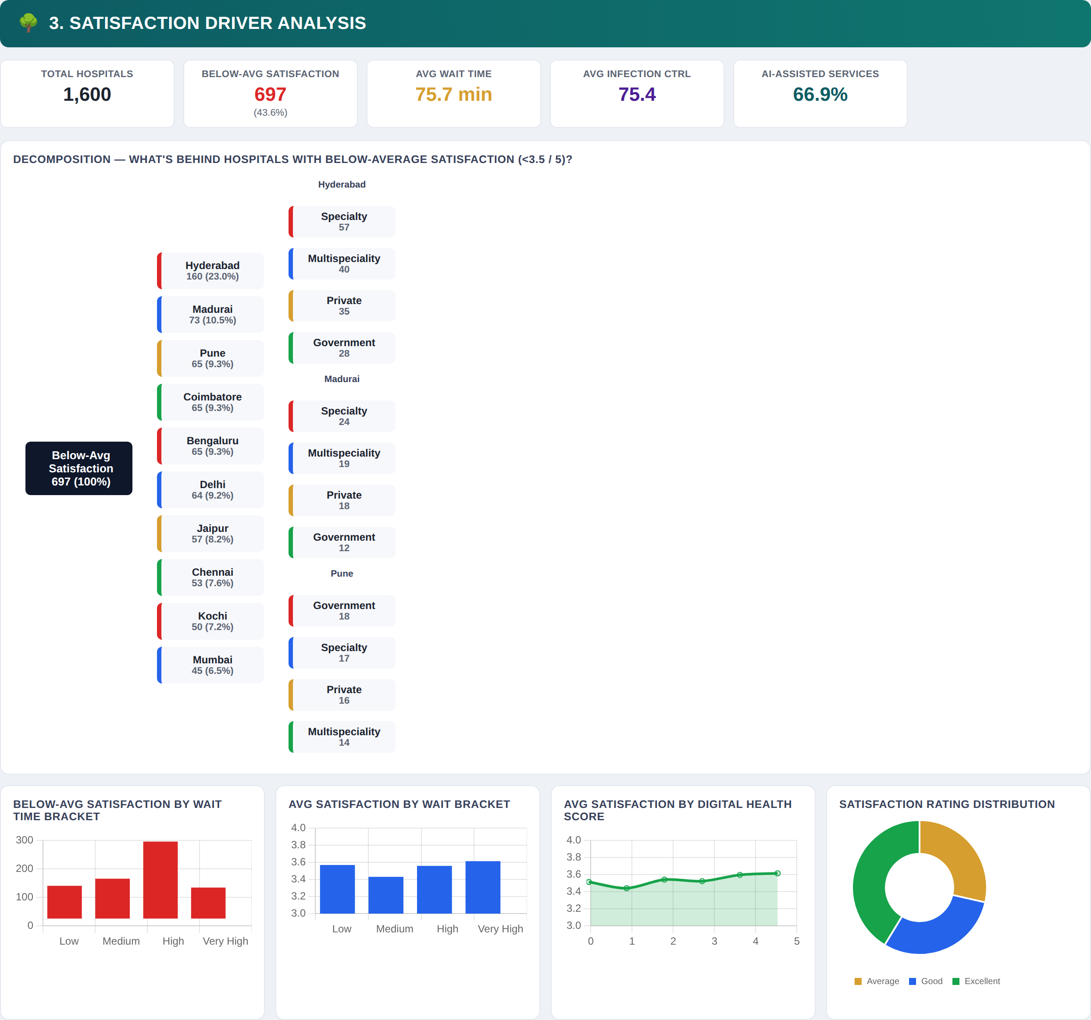
DASHBOARD 3 OF 7
Satisfaction Driver Analysis
Decomposing below-average patient satisfaction
AT A GLANCE
43.6%
75.7 min
BELOW-AVG SATISFACTION
AVG WAIT TIME
66.9%
75.4
AI-ASSISTED SERVICES
AVG INFECTION CTRL
KEY OBSERVATIONS
697 hospitals (43.6%) fall below the 3.5/5 satisfaction average.
Hyderabad drives the largest share of below-average cases — 160 hospitals (23.0%).
The High wait-time bracket has the most below-average-satisfaction hospitals.
Team 2 • Healthcare, Hospitality & Security Trends
7

Slide 8
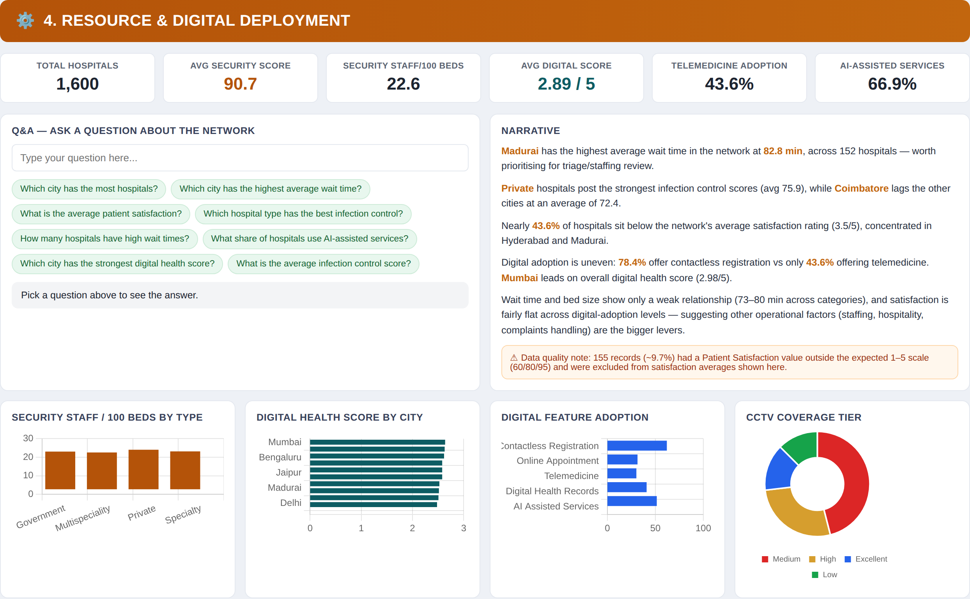
DASHBOARD 4 OF 7
Resource & Digital Deployment
Security staffing, digital adoption and a built-in Q&A explorer
AT A GLANCE
90.7
2.89 / 5
AVG SECURITY SCORE
AVG DIGITAL SCORE
43.6%
66.9%
TELEMEDICINE ADOPTION
AI-ASSISTED SERVICES
KEY OBSERVATIONS
Madurai has the network's highest average wait time — 82.8 min across 152 hospitals.
Digital adoption is uneven: 78.4% offer contactless registration vs only 43.6% telemedicine.
Mumbai leads on overall digital health score (2.98/5); a built-in Q&A box lets users ask questions directly.
Team 2 • Healthcare, Hospitality & Security Trends
8

Slide 9
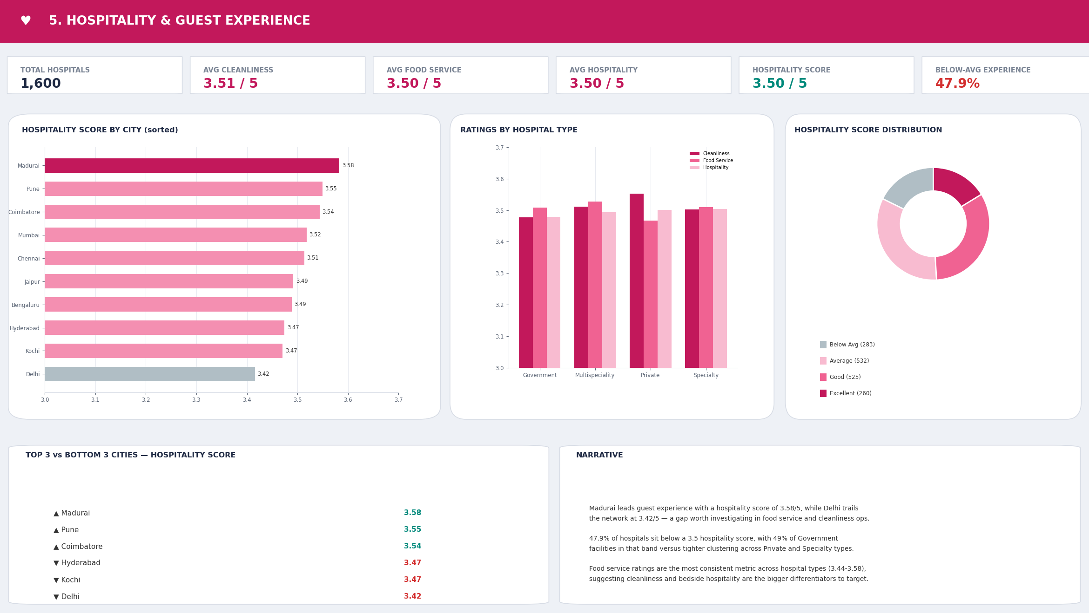
DASHBOARD 5 OF 7
Hospitality & Guest Experience
Cleanliness, food service and hospitality ratings
AT A GLANCE
3.50 / 5
3.51 / 5
HOSPITALITY SCORE
AVG CLEANLINESS
3.50 / 5
47.9%
AVG FOOD SERVICE
BELOW-AVG EXPERIENCE
KEY OBSERVATIONS
Madurai leads guest experience (3.58/5); Delhi trails the network (3.42/5).
47.9% of hospitals sit below a 3.5 hospitality score.
Food service ratings are the most consistent metric across hospital types (3.44–3.58).
Team 2 • Healthcare, Hospitality & Security Trends
9

Slide 10
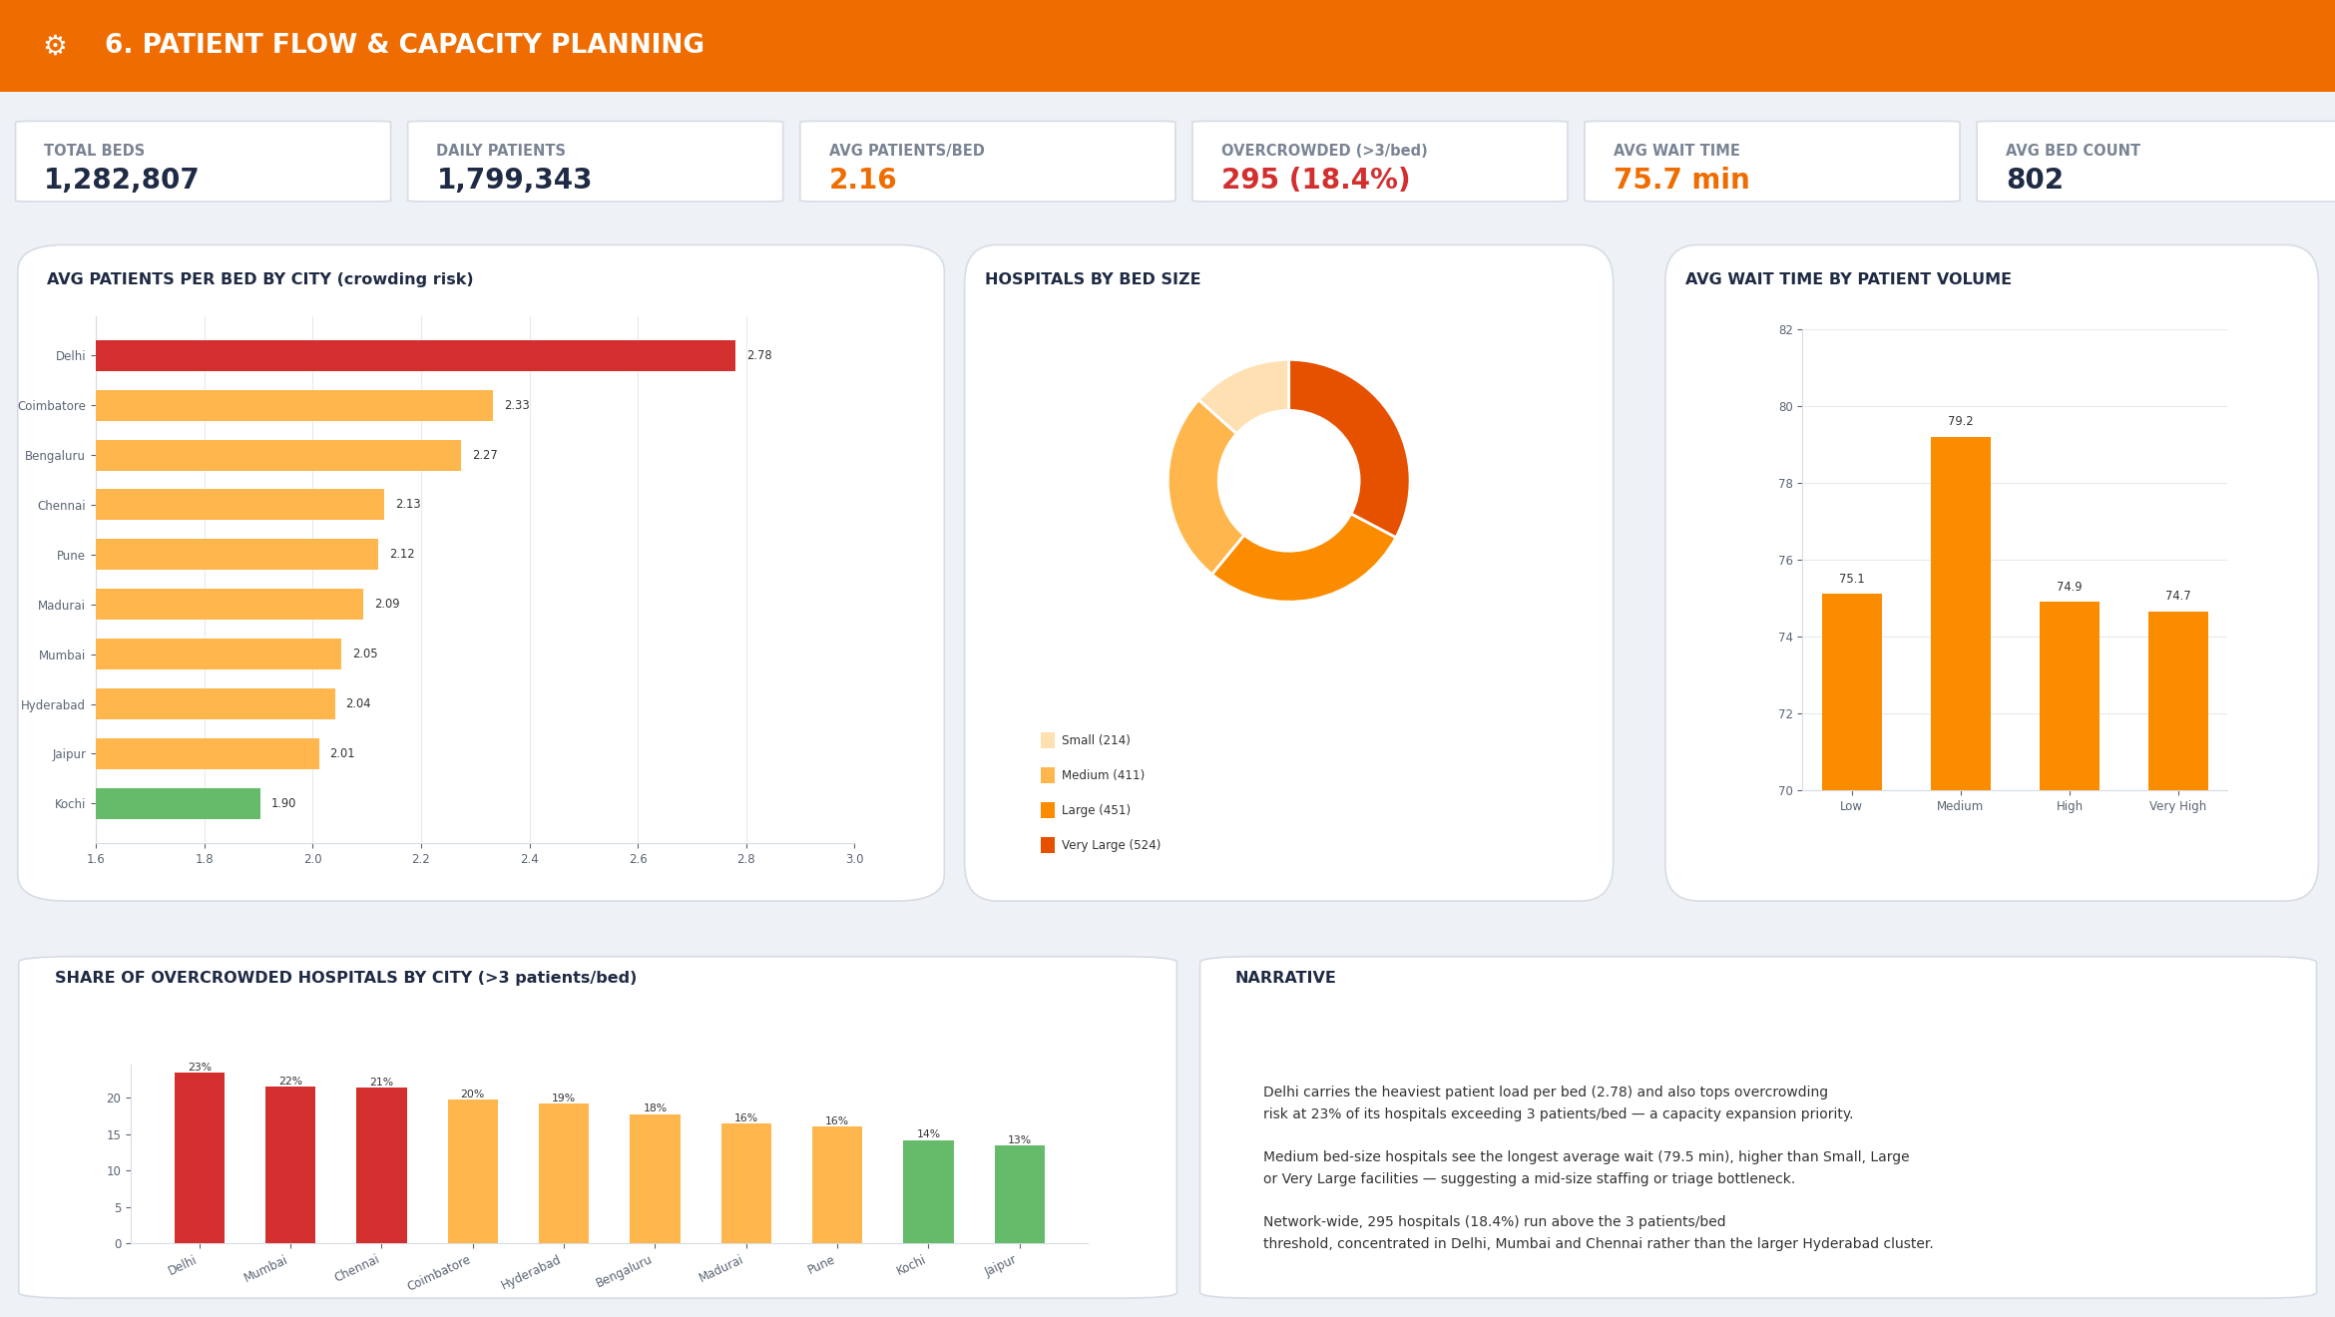
DASHBOARD 6 OF 7
Patient Flow & Capacity Planning
Crowding risk and wait times across the bed network
AT A GLANCE
2.16
18.4%
AVG PATIENTS / BED
OVERCROWDED (>3/BED)
75.7 min
802
AVG WAIT TIME
AVG BED COUNT
KEY OBSERVATIONS
Delhi carries the heaviest patient load per bed (2.78) and the highest overcrowding share (23%).
Medium bed-size hospitals see the longest average wait (79.2 min) of any group.
295 hospitals (18.4%) exceed 3 patients/bed, concentrated in Delhi, Mumbai and Chennai.
Team 2 • Healthcare, Hospitality & Security Trends
10

Slide 11
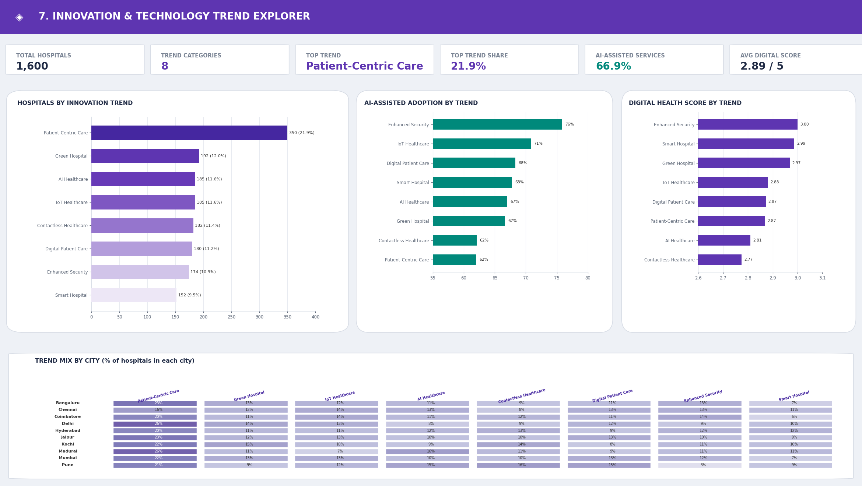
DASHBOARD 7 OF 7
Innovation & Technology Trend Explorer
Adoption of 8 innovation trends across the network
AT A GLANCE
21.9%
8
TOP TREND SHARE
TREND CATEGORIES
66.9%
2.89 / 5
AI-ASSISTED SERVICES
AVG DIGITAL SCORE
KEY OBSERVATIONS
Patient-Centric Care is the leading trend (350 hospitals, 21.9%) but has the lowest AI-assisted adoption (62%).
Enhanced Security shows the highest tech sophistication — 76% AI-assisted adoption and a 3.00/5 digital score.
Delhi and Madurai show the strongest lean toward Patient-Centric Care (26% of local hospitals each).
Team 2 • Healthcare, Hospitality & Security Trends
11

Slide 12
CROSS-DASHBOARD INSIGHTS
Key Insights Summary
1
Network Scale
2
Capacity Pressure
Hyderabad has the largest hospital footprint (329) yet also drives the most below-average-satisfaction cases (23%).
Delhi carries the heaviest load per bed (2.78) and the highest overcrowding share (23%) — a priority for expansion.
3
Wait-Time Pattern
4
Quality Leaders
Medium bed-size hospitals show the longest average wait (~79 min) across every dashboard that measures it.
Private hospitals post the strongest infection-control average (75.9) among the four hospital types.
5
Digital Gap
6
Innovation Trend
Contactless registration (78.4%) is far ahead of telemedicine adoption (43.6%) network-wide.
Patient-Centric Care leads adoption (21.9%) but trails on AI-assisted services and digital score.
Team 2 • Healthcare, Hospitality & Security Trends
12

Slide 13
PROGRESS & OUTCOME
What This Stage Delivered
7
1,600
10
40+
DASHBOARDS BUILT
HOSPITALS VISUALIZED
CITIES COVERED
KPIS & VISUALS
SUMMARY
The cleaned, feature-engineered dataset from the preprocessing stage was connected directly to Power BI, with no further manual data fixes required.
Seven themed dashboards were built — network overview, quality & risk, satisfaction drivers, resource & digital deployment, hospitality, patient flow and innovation trends.
Each dashboard combines KPI cards, charts, maps, filters and narrative call-outs, with a decomposition tree and an interactive Q&A box for deeper exploration.
A data-quality note flagged 155 records (~9.7%) with out-of-range satisfaction values, which were excluded from satisfaction averages to keep the numbers reliable.
Team 2 • Healthcare, Hospitality & Security Trends
13

Slide 14
CONCLUSION & NEXT STEPS
Conclusion & What's Next
CONCLUSION
NEXT STEPS
The dataset moved from raw, inconsistent records to a live, interactive dashboard suite.
Present the dashboard suite to the mentor / faculty panel for review
Seven Power BI dashboards now make network scale, quality, satisfaction, resources and innovation trends explorable at a glance.
Incorporate feedback and refine visuals, filters and layout
Add drill-through pages for individual hospital records
Built-in KPIs, filters, a decomposition tree and a Q&A box turn static numbers into an analysis tool a mentor or stakeholder can explore directly.
Set up a scheduled data refresh as new records are collected
Explore forecasting wait times and satisfaction trends
Team 2 • Healthcare, Hospitality & Security Trends
14

Slide 15
Thank You
A live, interactive dashboard suite — from clean data to actionable insight.
Team 2 • Kunal, Dinesh, Sarumathi

